Slide 1
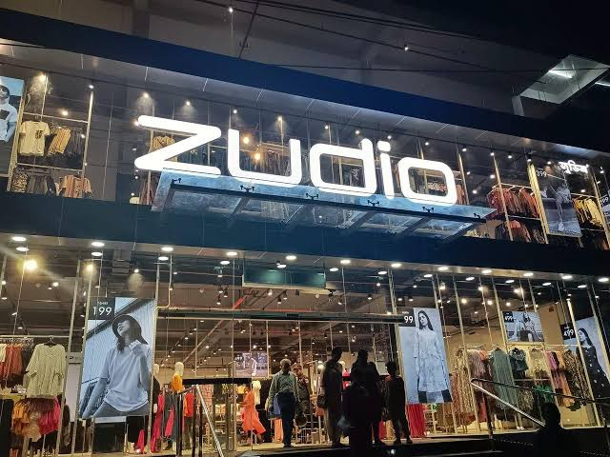


ZUDIO -
A BUSINESS ANALYSIS
BY SYED AYMAAN SAQIB

Slide 2
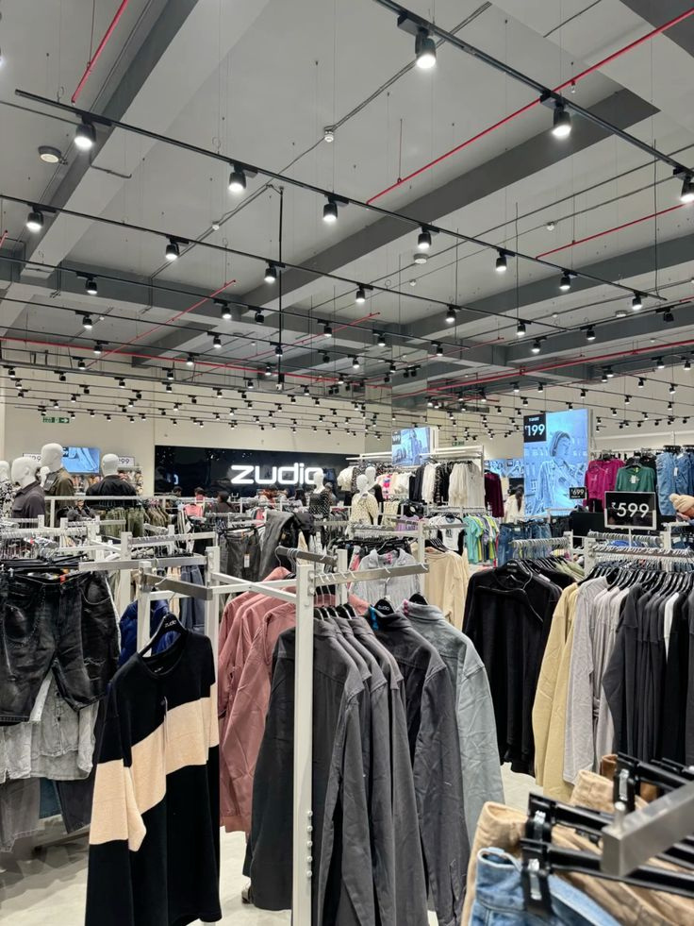
✅ Ultra-Affordable Pricing
✅ Fashion-Forward Offerin
✅ Store Expansion
✅ Private Label Strategy
✅ Diverse Product Range
Introduction
Zudio is one of India’s fastest-growing value fashion brands, launched by Trent Ltd (Tata Group).
It caters to young, trend-conscious consumers by offering affordable, stylish, and fast-moving fashion across apparel, footwear, and accessories.
With a rapidly expanding retail presence, Zudio has grown to 545+ stores across 164 cities (as of FY24) and continues to dominate the fast-fashion segment.
Unlike traditional retailers, Zudio operates on a private-label model, ensuring a faster design-to-shelf cycle, competitive pricing, and higher margins.

Slide 3
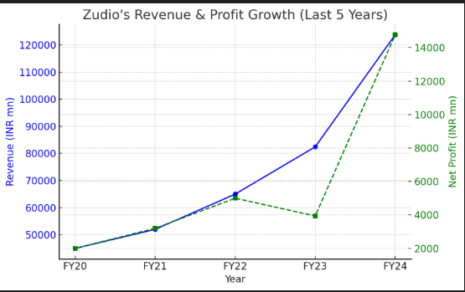
The blue line represents revenue, while the green dashed line represents net profit.
Zudio's revenue has shown consistent and significant growth over the five years.
In FY20, revenue was approximately INR 50,000 million and steadily increased to around INR 120,000 million by FY24.
From FY20 to FY22, net profit steadily increased, reflecting operational efficiency or better cost management.
Revenue and Profit Growth
(FY20-24)

Slide 4
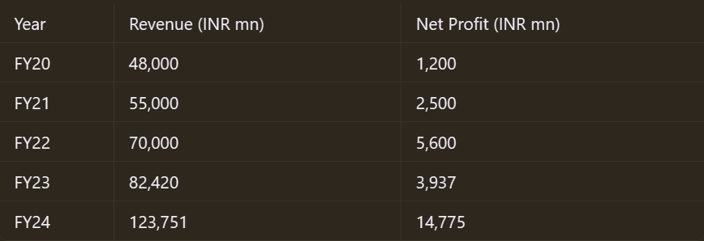
However, there was a dip in net profit in FY23 despite revenue growth, suggesting increased costs, reduced margins, or external challenges.
In FY24, net profit surged dramatically to approximately INR 14,000 million, aligning with the steep rise in revenue. This indicates improved profitability and operational efficiency.
The divergence between revenue and profit trends in FY23 suggests that while sales were growing, profitability faced temporary setbacks.
The sharp recovery in FY24 highlights successful cost control measures or higher-margin products/services contributing to profitability.

Slide 5
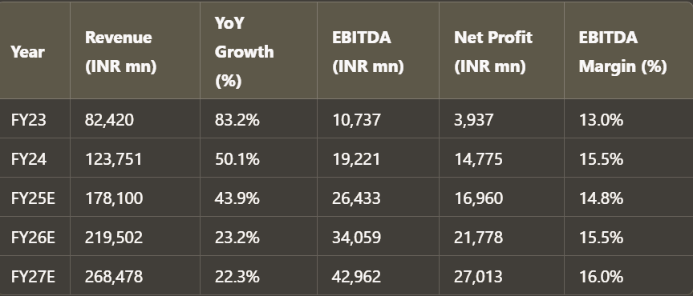
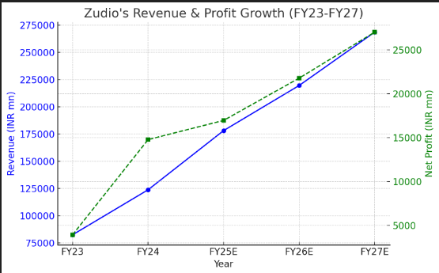
Revenue and Profit Growth
(FY23-27)
Revenue CAGR* of 27% (FY24-FY27), outpacing the broader apparel market.
EBITDA** margin improves from 13% in FY23 to 16% in FY27.
Net profit growing at 38% CAGR, indicating strong operational efficiency.
Zudio accounts for a significant portion of Trent’s revenue growth, contributing to its rapid valuation increase.
*CAGR-Compound Annual Growth Rate
**EBITDA-Earnings Before Interest, Taxes, Depreciation, and Amortization

Slide 6

Net profit drop in FY23 was due to:
Increased store expansion costs, leading to higher capital expenditures.
Rising input costs, including inflation and supply chain disruptions.
Investment in new segments, such as Zudio Beauty and accessories.
Higher employee & marketing costs to support aggressive growth.

Slide 7
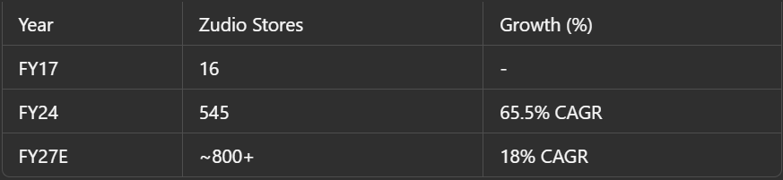
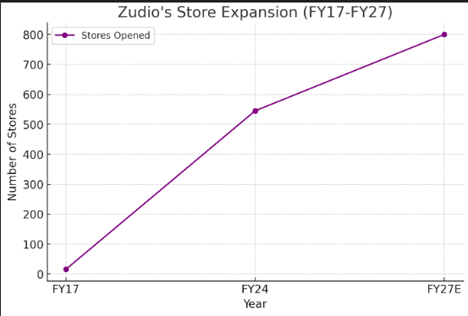
Zudio’s Store Expansion & Market Share
Zudio grew from 16 stores in FY17 to 545 stores in FY24.
This represents a remarkable CAGR of 65.5%, indicating aggressive expansion during this period.
The number of stores is projected to reach approximately 800+ by FY27.
The CAGR for this period is expected to moderate to 18%, suggesting a shift from rapid expansion to more measured growth.
From FY17 to FY27E, Zudio is on track to achieve significant scale, growing its store count by 50 times over a decade.
Expansion is focused on Tier I & II cities.
Aggressive penetration in non-metro cities presents a huge untapped opportunity.
Zudio’s per-store revenue is significantly higher than industry averages, showcasing strong operational efficiency.

Slide 8
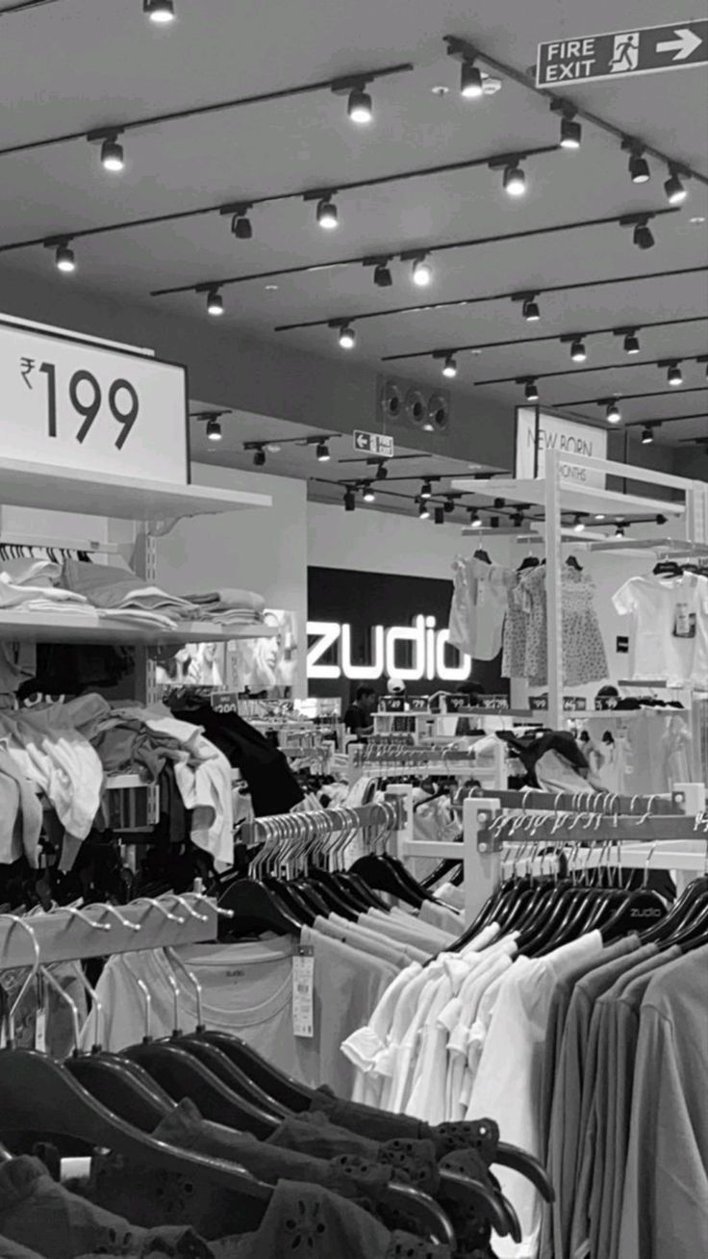
Trends:
Initial Aggressive Scaling: The high CAGR of 65.5% between FY17 and FY24 reflects Zudio's focus on capturing market share quickly, likely driven by increasing demand for affordable fashion.
Saturation and Consolidation: The lower CAGR of 18% from FY24 to FY27E may indicate market saturation or a strategic focus on optimizing operations and profitability rather than sheer expansion.
Market Positioning: The consistent growth trajectory underscores Zudio's success in establishing itself as a key player in the value fashion retail segment.

Slide 9
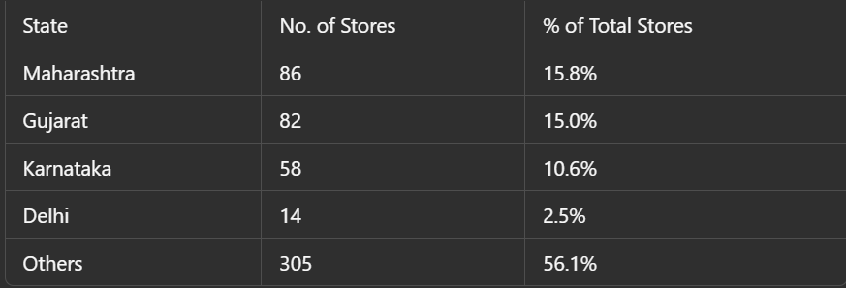
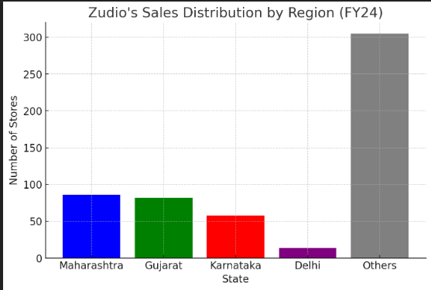
Sales Distribution & Consumer Trends
Your text
Maharashtra leads with 86 stores, accounting for 15.8% of the total.
Gujarat closely follows with 82 stores (15.0%).
Karnataka has 58 stores (10.6%), while Delhi has only 14 stores (2.5%).
A majority of the stores (56.1%), i.e., 305 stores, fall under the "Others" category, indicating either a wide spread across smaller states or regions not explicitly listed.
Maharashtra and Gujarat are nearly equal in terms of store count and percentage, showing balanced representation.
Delhi has significantly fewer stores compared to other states, contributing only 2.5% to the total.

Slide 10

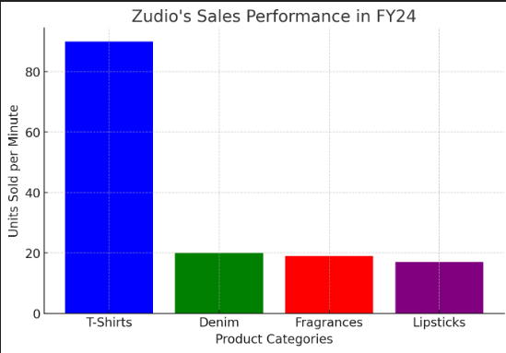
Sales Performance by Product Category
Dominant Product Category: T-shirts significantly outperform all other categories, with approximately 88 units sold per minute. This indicates a strong demand for t-shirts.
Other Categories: Denim and Fragrances have similar sales figures, around 20 units per minute, while Lipsticks have the lowest sales at approximately 17 units per minute.
Overall Trend: There is a clear disparity in sales performance among the product categories. T-shirts are the most popular, while the other three categories have considerably lower sales.

Slide 11
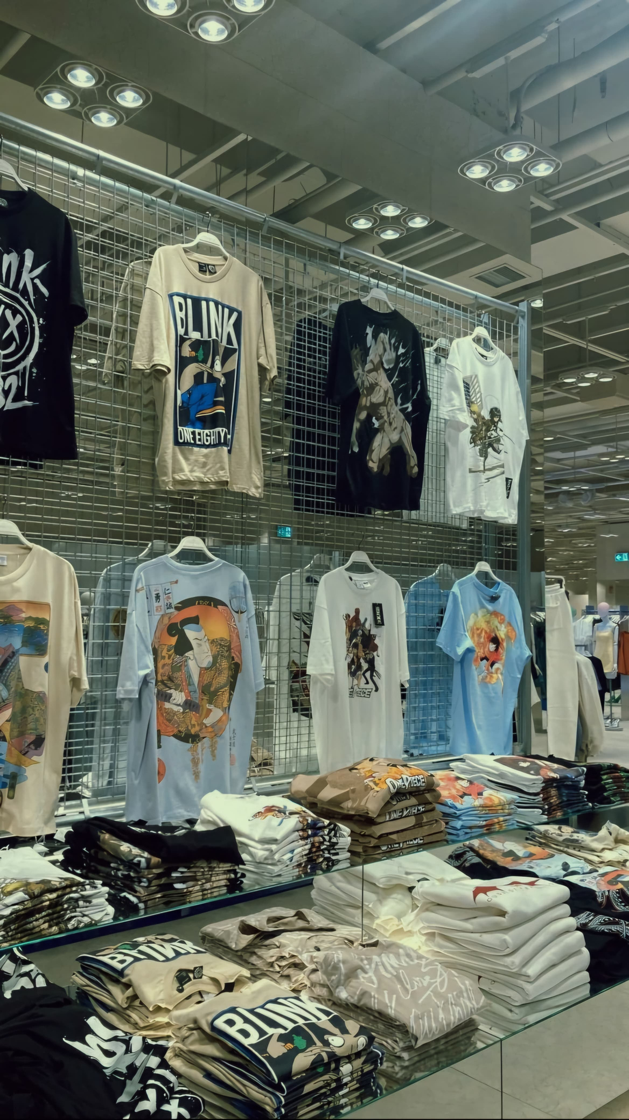
Trends Identified:
Regional Dominance:
The "Others" category suggests that smaller states or less prominent regions collectively host a significant portion of the stores, highlighting decentralization in store distribution.
2. Balanced Presence in Key States:
Maharashtra and Gujarat are key markets with similar store counts and percentages, indicating their importance for business operations.
3. Potential Growth Opportunity in Delhi:
Delhi's low store count could signal untapped potential for expansion in this region.

Slide 12
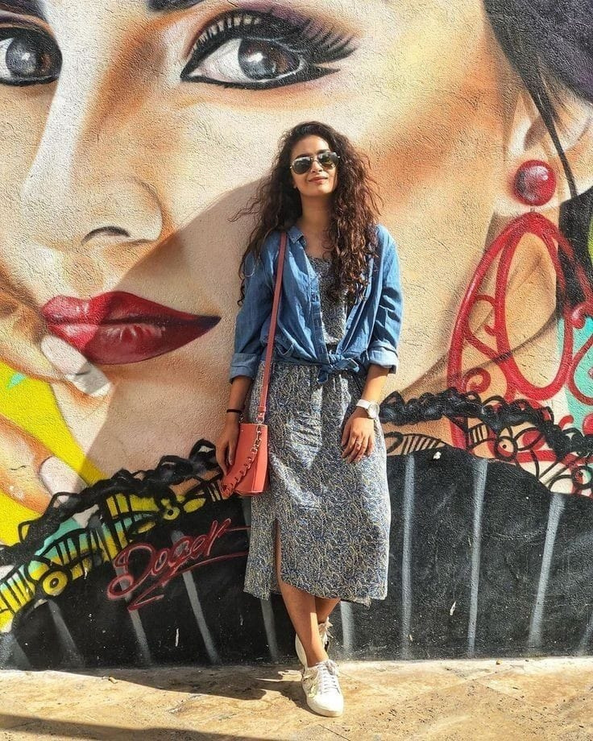
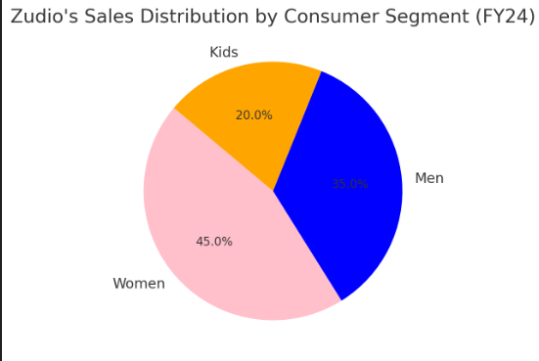
Consumer Segments Contribution
Women are the largest consumer segment: Women account for 45% of Zudio's sales, making them the most significant customer base.
Men are a substantial segment: Men contribute 35% of sales, indicating a strong male customer base as well.
Kids represent a smaller portion: The kids' segment makes up 20% of sales, the smallest of the three.

Slide 13
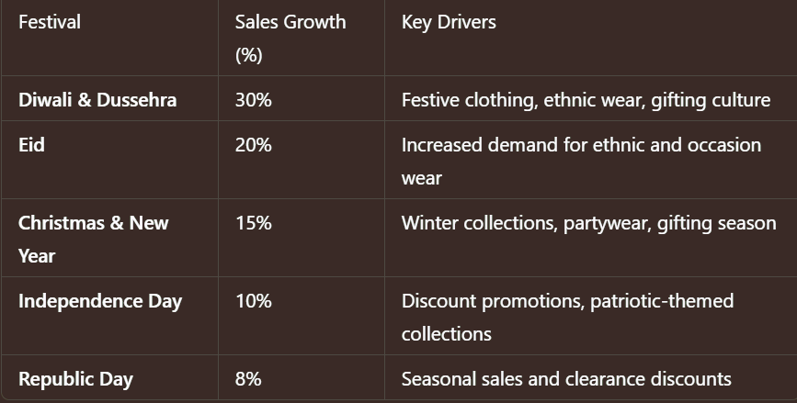
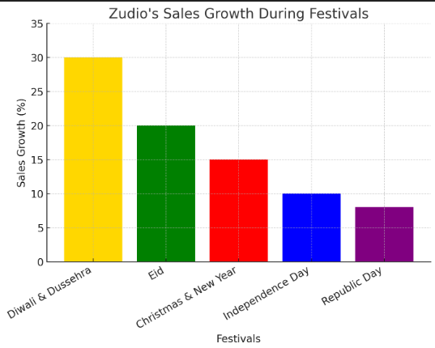
Sales Performance During Festivals
Diwali sees the highest sales surge (30-40% increase), as consumers shop for festive and ethnic wear.
Eid follows with a 15-25% rise, driven by demand for traditional and fusion fashion.
Christmas and New Year sales peak at 20-30%, focusing on partywear and winter collections.
Independence Day and Republic Day contribute to moderate growth (~10-15%) due to discount-led promotions.

Slide 14
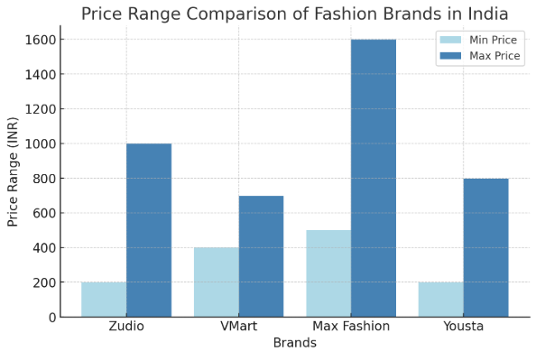
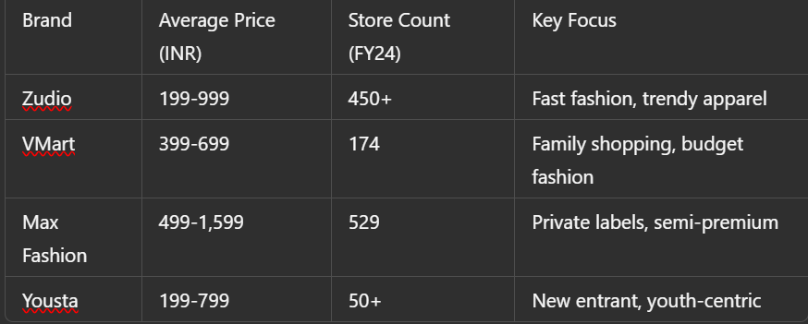
Competitive Analysis (Zudio vs. Peers)
Price: Zudio and Yousta compete on similar low price points, targeting budget-conscious shoppers. Zudio offers slightly more value than VMart. Max Fashion is significantly pricier.
Reach: Max Fashion has the most stores, giving it the widest reach. Zudio is second, showing strong expansion. Yousta is building its presence.
Focus: Zudio is "fast fashion," competing with Yousta for younger, trend-driven customers. VMart targets families. Max Fashion offers a semi-premium experience.

Slide 15
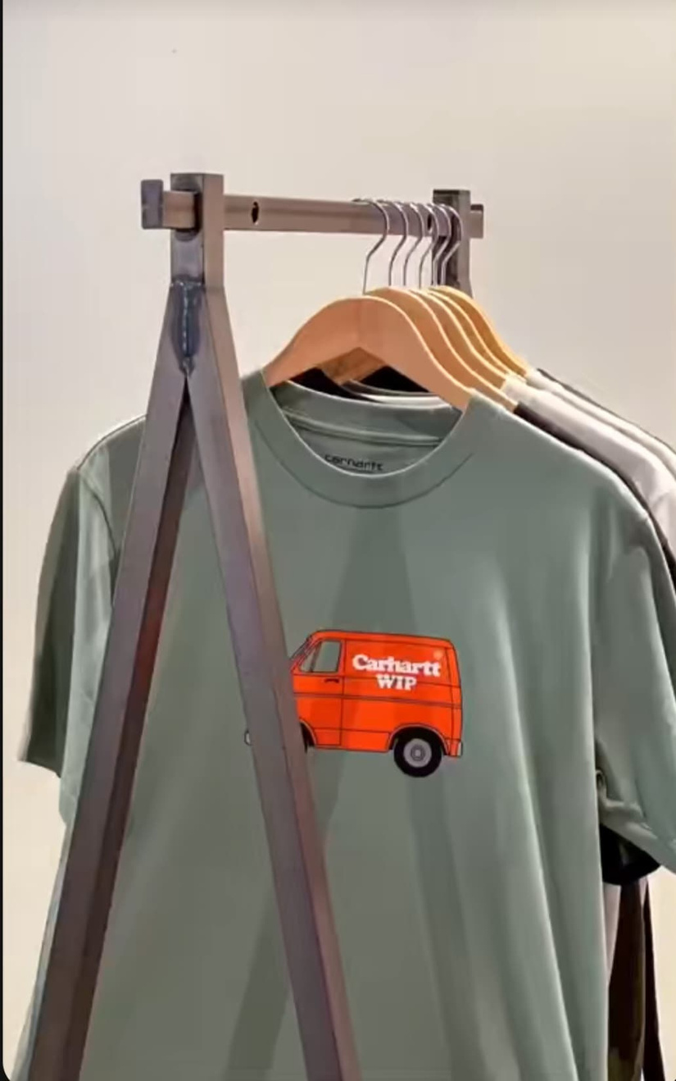
Key Insight: Zudio balances affordability with trendiness, positioned between budget family options and premium private labels. Yousta is a direct threat needing Zudio to maintain trend leadership.
Zudio holds 33% market share in fast fashion.
Outpaced VMart (26%) and other competitors in store expansion.
Expansion is focused on Tier I & II cities.

Slide 16
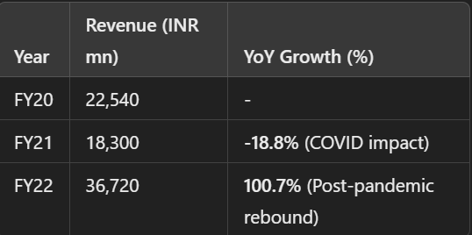
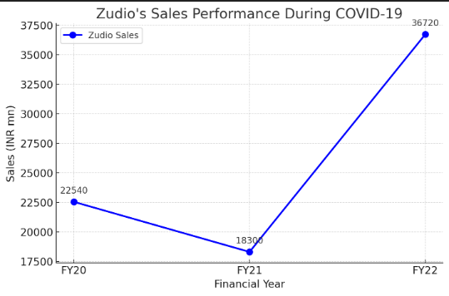
COVID19 And Its EFFECTS
FY21 saw a revenue dip of 18.8%, reflecting the challenges of lockdowns.With restrictions and reduced footfall, Zudio saw temporary revenue contraction, but its parent company, Trent Ltd, maintained financial stability due to diversified revenue streams.
FY22 sales doubled (100.7% growth) due to aggressive expansion and strong consumer demand post-pandemic.By FY22-FY23, sales rebounded sharply, benefiting from revenge shopping and renewed consumer confidence.

Slide 17

Key Strategies for Survival:
Cost Efficiency & Lean Operations: Zudio continued minimizing advertising costs, relying on organic marketing and word-of-mouth.
Selective E-commerce Push: While primarily an offline brand, Zudio adapted by testing online sales in limited cities via Tata’s e-commerce platforms like Tata Cliq.
Quick Recovery & Expansion Post-Lockdown: Post-pandemic, Zudio aggressively resumed store expansions, capitalizing on pent-up demand.

Slide 18
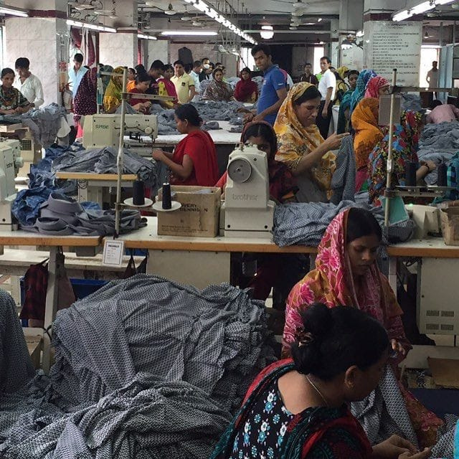
Word-of-Mouth Marketing: High customer satisfaction leads to organic brand promotion.
Strategic Store Locations: Presence in high-footfall areas ensures natural visibility.
Social Media & Digital Engagement: Leveraging Instagram and influencer marketing instead of traditional ads.
Strong Tata Brand Trust: Consumers associate Zudio with Trent Ltd’s reputation for quality and affordability.
Affordable Pricing & Trendy Fashion: Ensures consistent customer demand without heavy promotional spending.
In-Store Experience & Fast Turnover: New collections drive repeat footfall, maintaining high engagement.
The
X-Factor
Zudio follows a low advertising strategy as part of its overall business modelInstead of spending heavily on advertisements, the brand invests in supply chain efficiency, store expansion, and product affordability.

Slide 19

Expansion & Market Penetration:
Expand aggressively in Tier II & III cities.
Strengthen omnichannel presence with e-commerce integration.
Consider international expansion in Southeast Asia & the Middle East.
2. Pricing & Competitive Positioning:
Maintain affordable pricing while introducing premium sub-brands.
Offer personalized discounts and festival-based promotions.
3.Supply Chain & Operational Efficiency:
Optimize inventory management using AI forecasting.
Improve logistics for faster store replenishment.
Conclusion and Future Outlook
Zudio is set to remain the leader in fast fashion with a projected 37% sales CAGR.
Trent Ltd (Parent Company) expected to post a 38% PAT CAGR.
Target price for Trent Ltd: INR 8,500 (38% upside from CMP of INR 6,161 as of Jan 2025).

Slide 20

. Product & Brand Innovation:
Launch eco-friendly fashion to attract sustainability-conscious consumers.
Grow Zudio Beauty & Accessories segment.
Collaborate with influencers for limited-edition drops.
3. Customer Experience & Loyalty:
Implement a loyalty program to increase repeat purchases.
Introduce tech-driven shopping experiences (e.g., virtual try-ons).

Slide 21
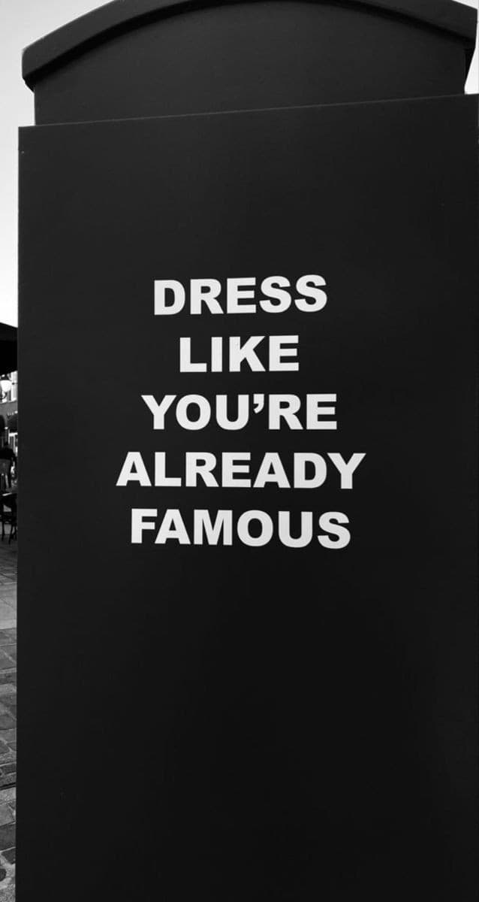
Thank You

